Slide 1
Introduction to programming
Introduction To C
Shubham Dhungana

Slide 2
History
C is a high level language developed by Dennis M. Ritchie.
It was developed to write UNIX operating system.
C is a successor of B language.
Some of the most popular Linux OS and RDBMS MYSQL have been written in C.

Slide 3
C- Program Structure
C program files ends with a “ .c “ extension.
Starts with comments
Processor directive
Global variable declaration
Main function(){
statements;
}

Slide 4
Comments
Comments are used to increase the readability of the program.
Comments are generally written in plain English language.
/* ....................................... */ is used for multi lines comments
// is used for the single lines of comments

Slide 5
Processor directives
It tells the compiler to include information about the particular header files.
For example:
#include <stdio.h> The stdio.h (standard input output header file) contains definition &declaration of system defined function such as printf( ), scanf( ), pow( ) etc. Generally printf() function used to display and scanf() function used to read value

Slide 6
Main()
It is the user defined function and every function has one main() function from where actually program is started and it is encloses within the pair of curly braces.
The main( ) function can be anywhere in the program but in general practice it is placed in the first position

Slide 7
First Program in C
/*Program to print hello world */
#include <stdio.h>
int main()
{
printf(“ Hello World “);
return 0;
}

Slide 8
Identifiers
Identifiers Identifiers are user defined word used to name of entities like variables, arrays, functions, structures etc. Rules for naming identifiers are: 1) name should only consists of alphabets (both upper and lower case), digits and underscore (_) sign. 2) first characters should be alphabet or underscore 3) name should not be a keyword 4) since C is a case sensitive, the upper case and lower case considered differently, for example code, Code, CODE etc. are different identifiers. 5) identifiers are generally given in some meaningful name such as value, net_salary, age, data etc. An identifier name may be long, some implementation recognizes only first eight characters, most recognize 31 characters. ANSI standard compiler recognize 31 characters. Some invalid identifiers are 5cb, int, res#, avg no etc.

Slide 9
Keywords
There are certain words reserved for doing specific task, these words are known as reserved word or keywords.
These words are predefined and always written in lower case or small letter.
These keywords cann’t be used as a variable name as it assigned with fixed meaning.
Examples: int, short, signed, unsigned, default, volatile, float, long, double, break, continue, typedef, static, do, for, union, return, while, do, extern, register, enum, case, goto, struct, char, auto, const etc.

Slide 10
Data Types
Data types refer to an extensive system used for declaring variables or functions of different types before its use.
The type of a variable determines how much space it occupies in storage and how the bit pattern stored is interpreted.

Slide 11
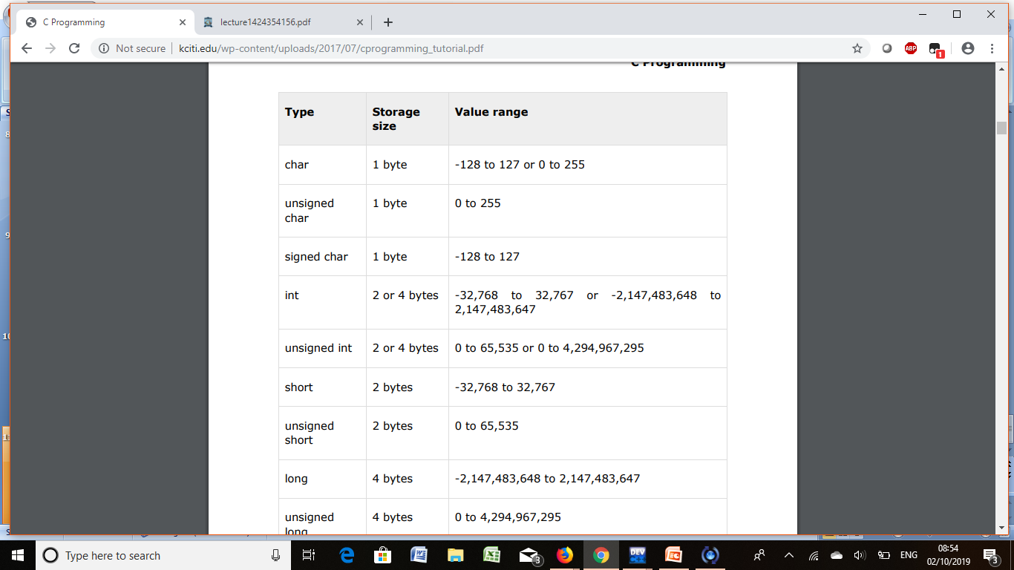
Integer Data Types

Slide 12
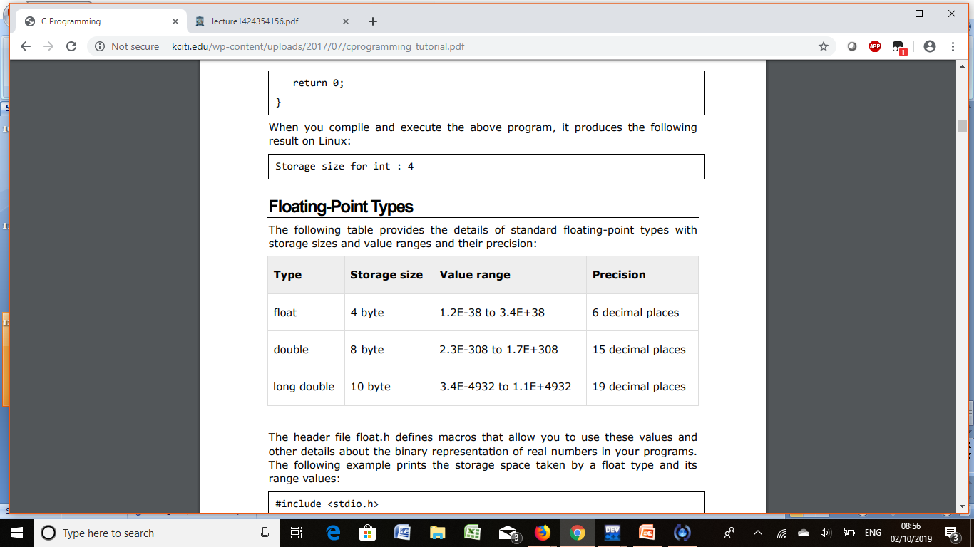
Floating data type

Slide 13
Variables
A variable is nothing but a name given to a storage area that our programs can manipulate.
Each variable in C has a specific type, which determines the size and layout of the variable's memory; the range of values that can be stored within that memory; and the set of operations that can be applied to the variable.

